Slide 1
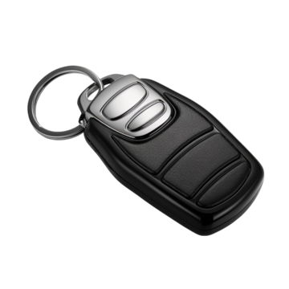
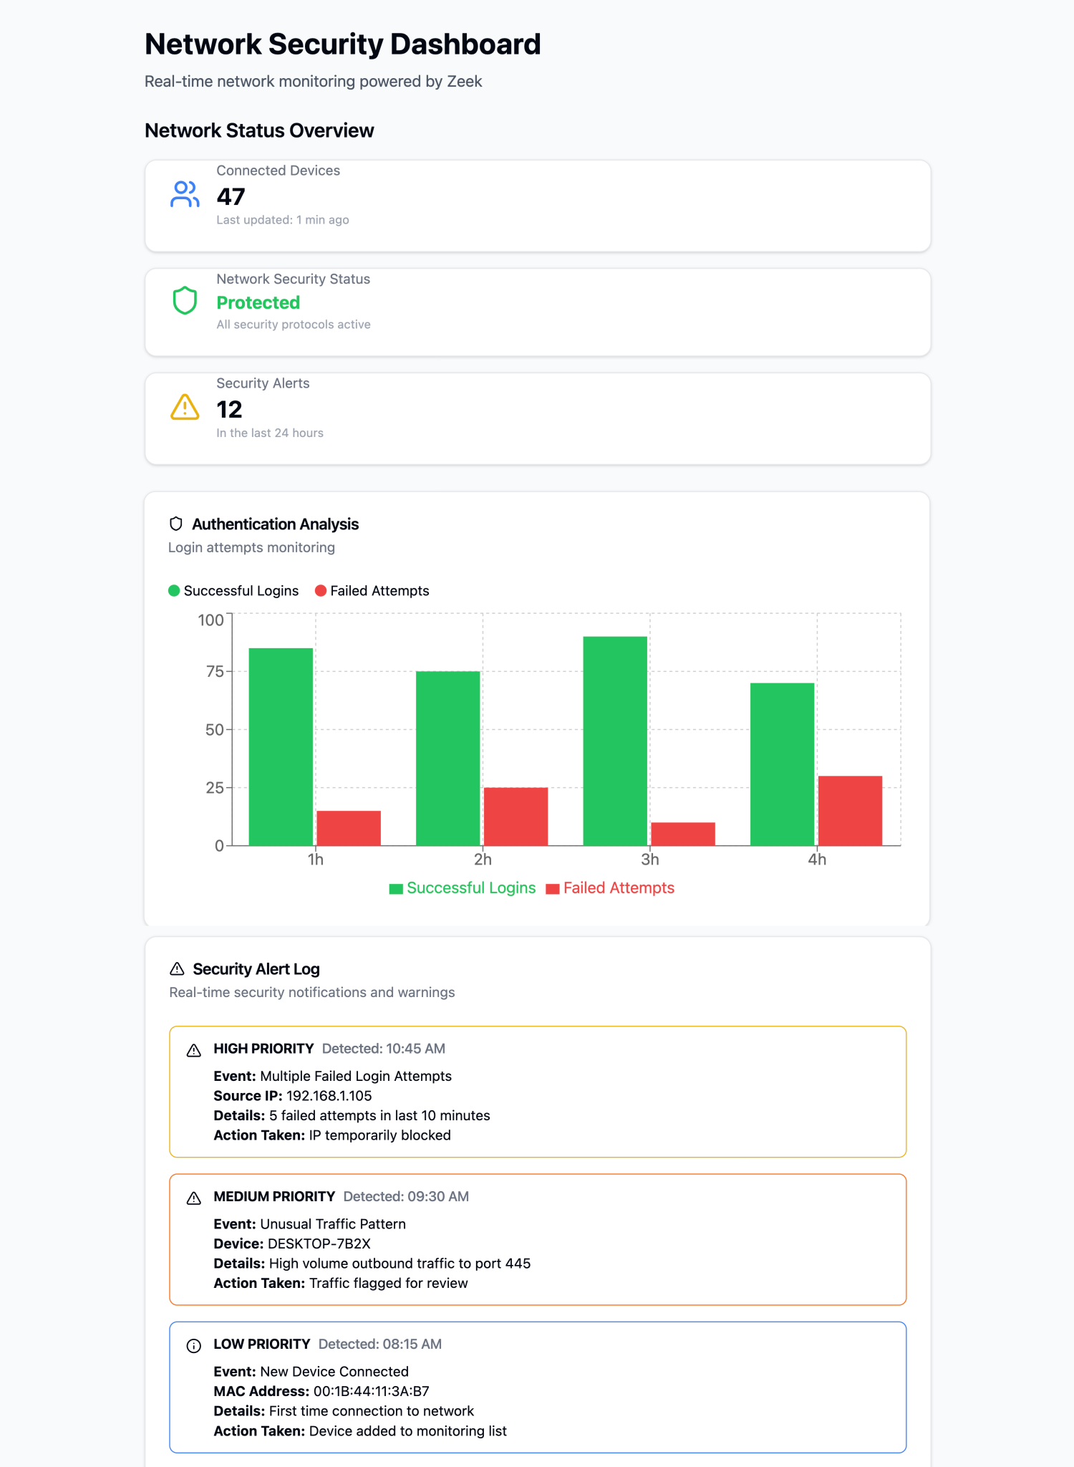

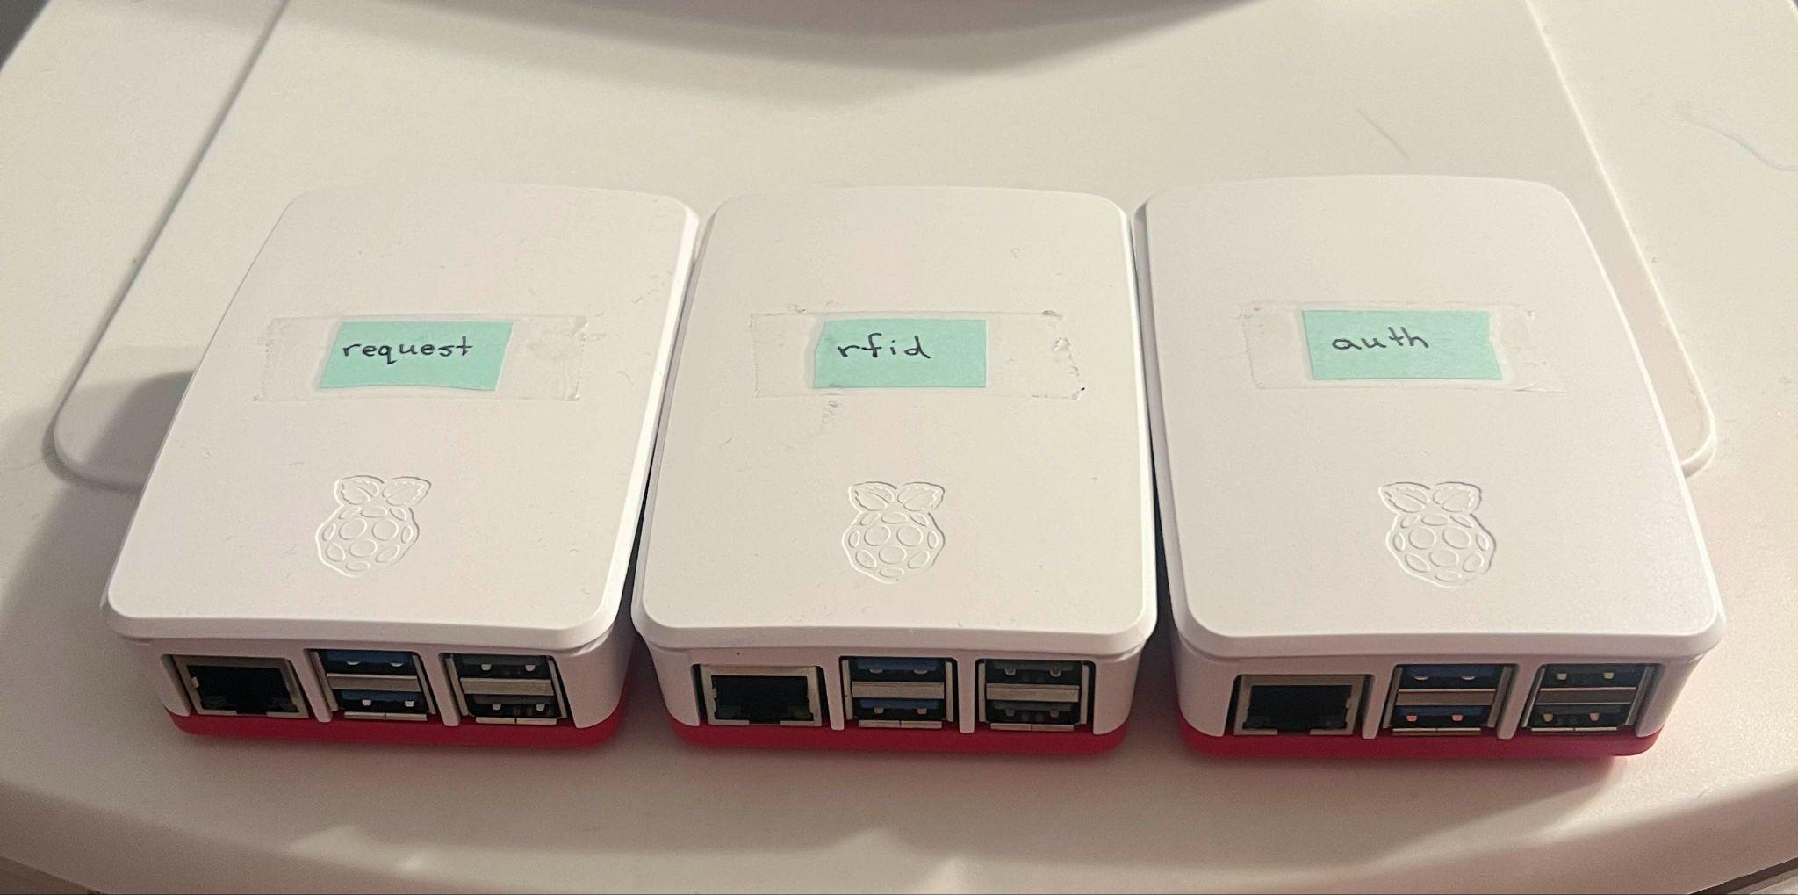
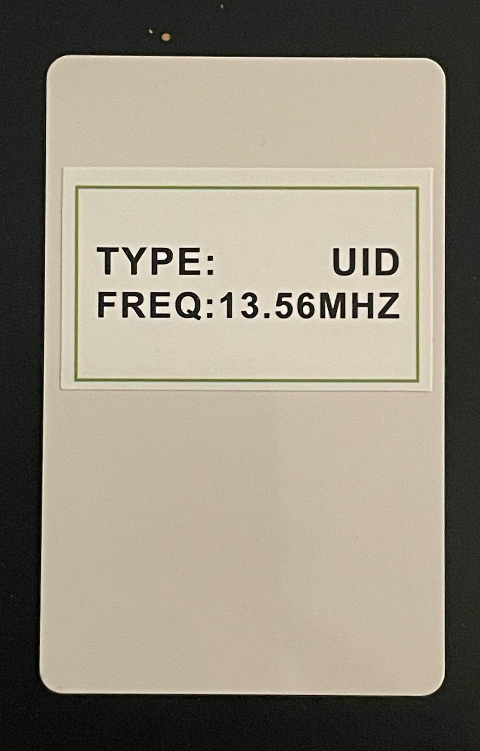
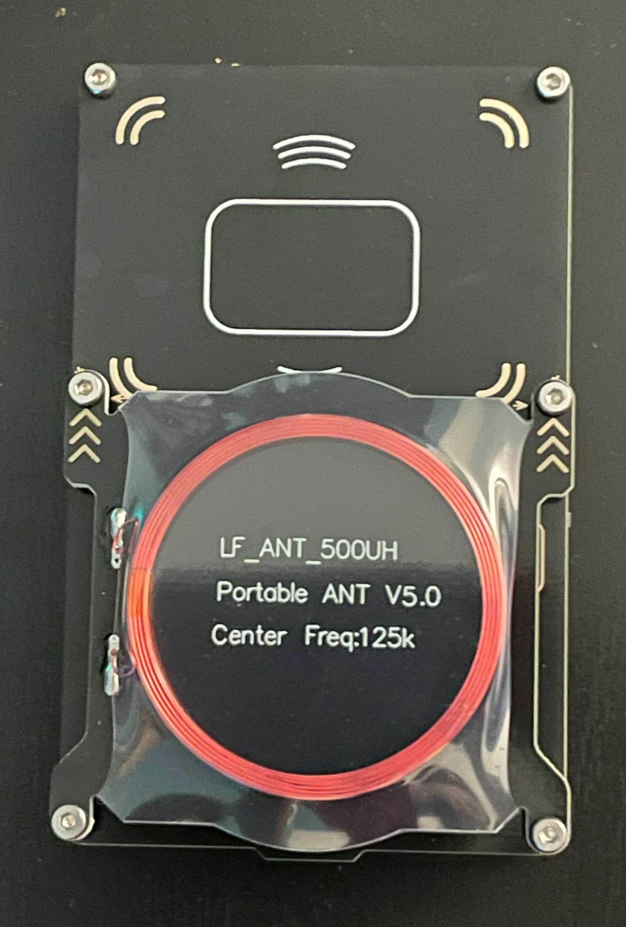
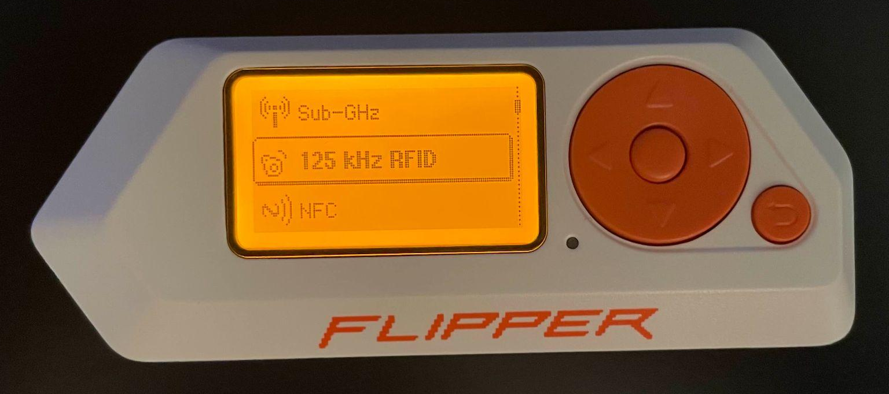
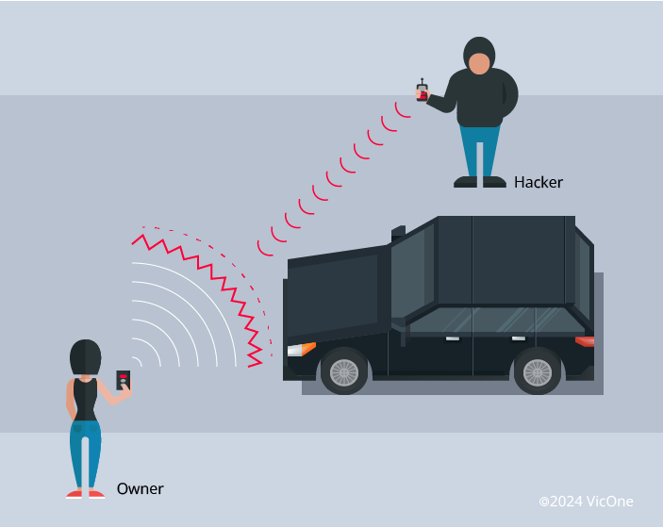
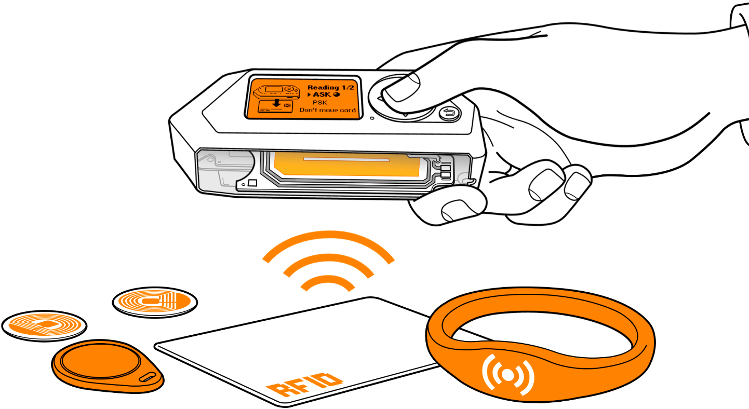
25-341
RFID Attack Detection
Team members: Chris Malatesta, Calvin Hurlbert, Jaspreet Singh, Keith Tran | Faculty adviser: Milos Manic | Sponsor: Idaho National Laboratory | Mentor: Bjorn Vaagensmith
Motivation
Tools
Solution
RFID attacks have become not only easy to carry out but are also almost impossible to detect without special equipment.
Using Raspberry pi’s to run servers, we can host a testbed to run attacks through.
We can streamline attacks with a Flipper Zero running through a Proxmox
Attacks
There are many types of attacks out there and we will be focusing on two, denial of service and brute force.
Citations
Yang O. (2024, June 7). From Key Fob to UWB: How Hackers Hijack Vehicle Entry Systems. Retrieved from https://vicone.com/blog/from-key-fob-to-uwb-how-hackers-hijack-vehicle-entry-systems
PNGKey. (n.d.). Plastic Hotel Key Cards - Key Card Design Template. Retrieved from https://www.pngkey.com/maxpic/u2y3w7a9q8u2y3w7/
PNGTree. (n.d.). Sleek Leather Key Fob Case - Perfect Fit and Ultimate Protection for Car Keys. Retrieved from https://pngtree.com/freepng/sleek-leather-key-fob-case-perfect-fit-and-ultimate-protection-for-car-keys_15892661.html
Flipper Zero Documentation. (n.d.). RFID Read. Retrieved from https://docs.flipper.net/rfid/read
Graphs generated with Claude

